Slide 1

Travel Eye
Adam Wisnewski, Jacob Philips, Erand Bizati, Owen Campain

Slide 2

What is the purpose?
Ever felt unsafe in a new place?
Felt like someone is watching you or listening to you?
Help travelers feel safe
Check for devices which may be monitoring you
Give travelers the best experience possible knowing they aren't having their privacy invaded

Slide 3
High Level Requirements
Allow users to scan a room for wireless signals to help find any hidden surveillance devices
Provide information to aid in finding hidden devices as well as how to possibly disable them
Have this contained in one portable device that is easy to use a requires little technical knowledge

Slide 4
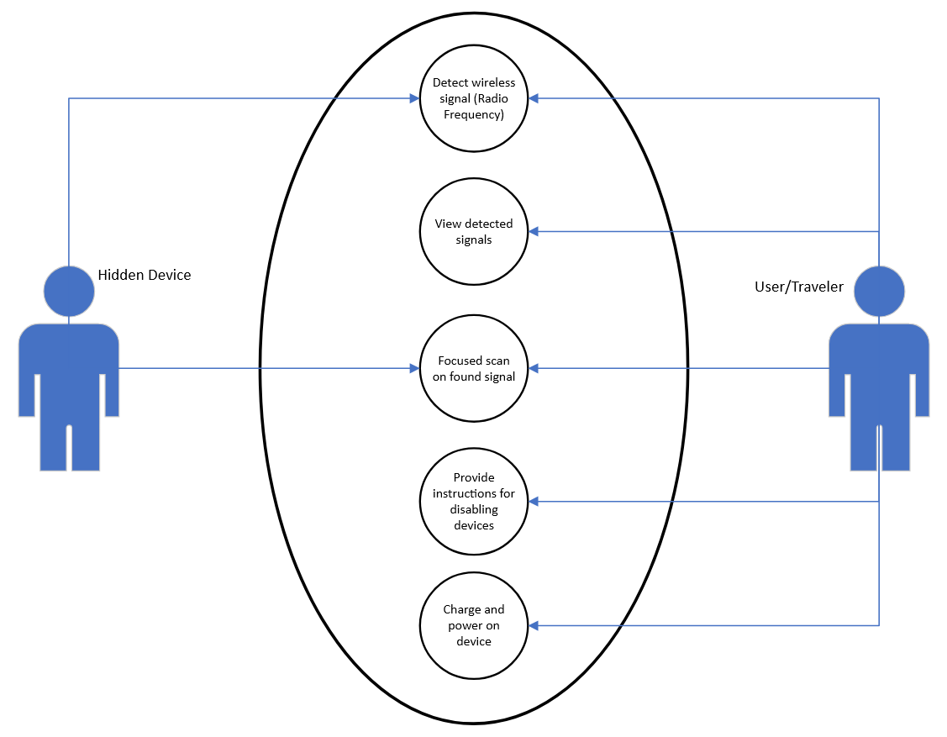
Use Case Diagram

Slide 5
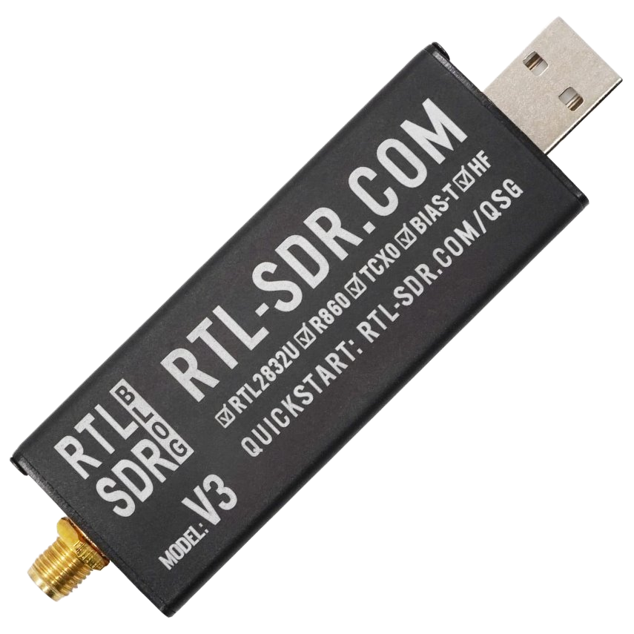
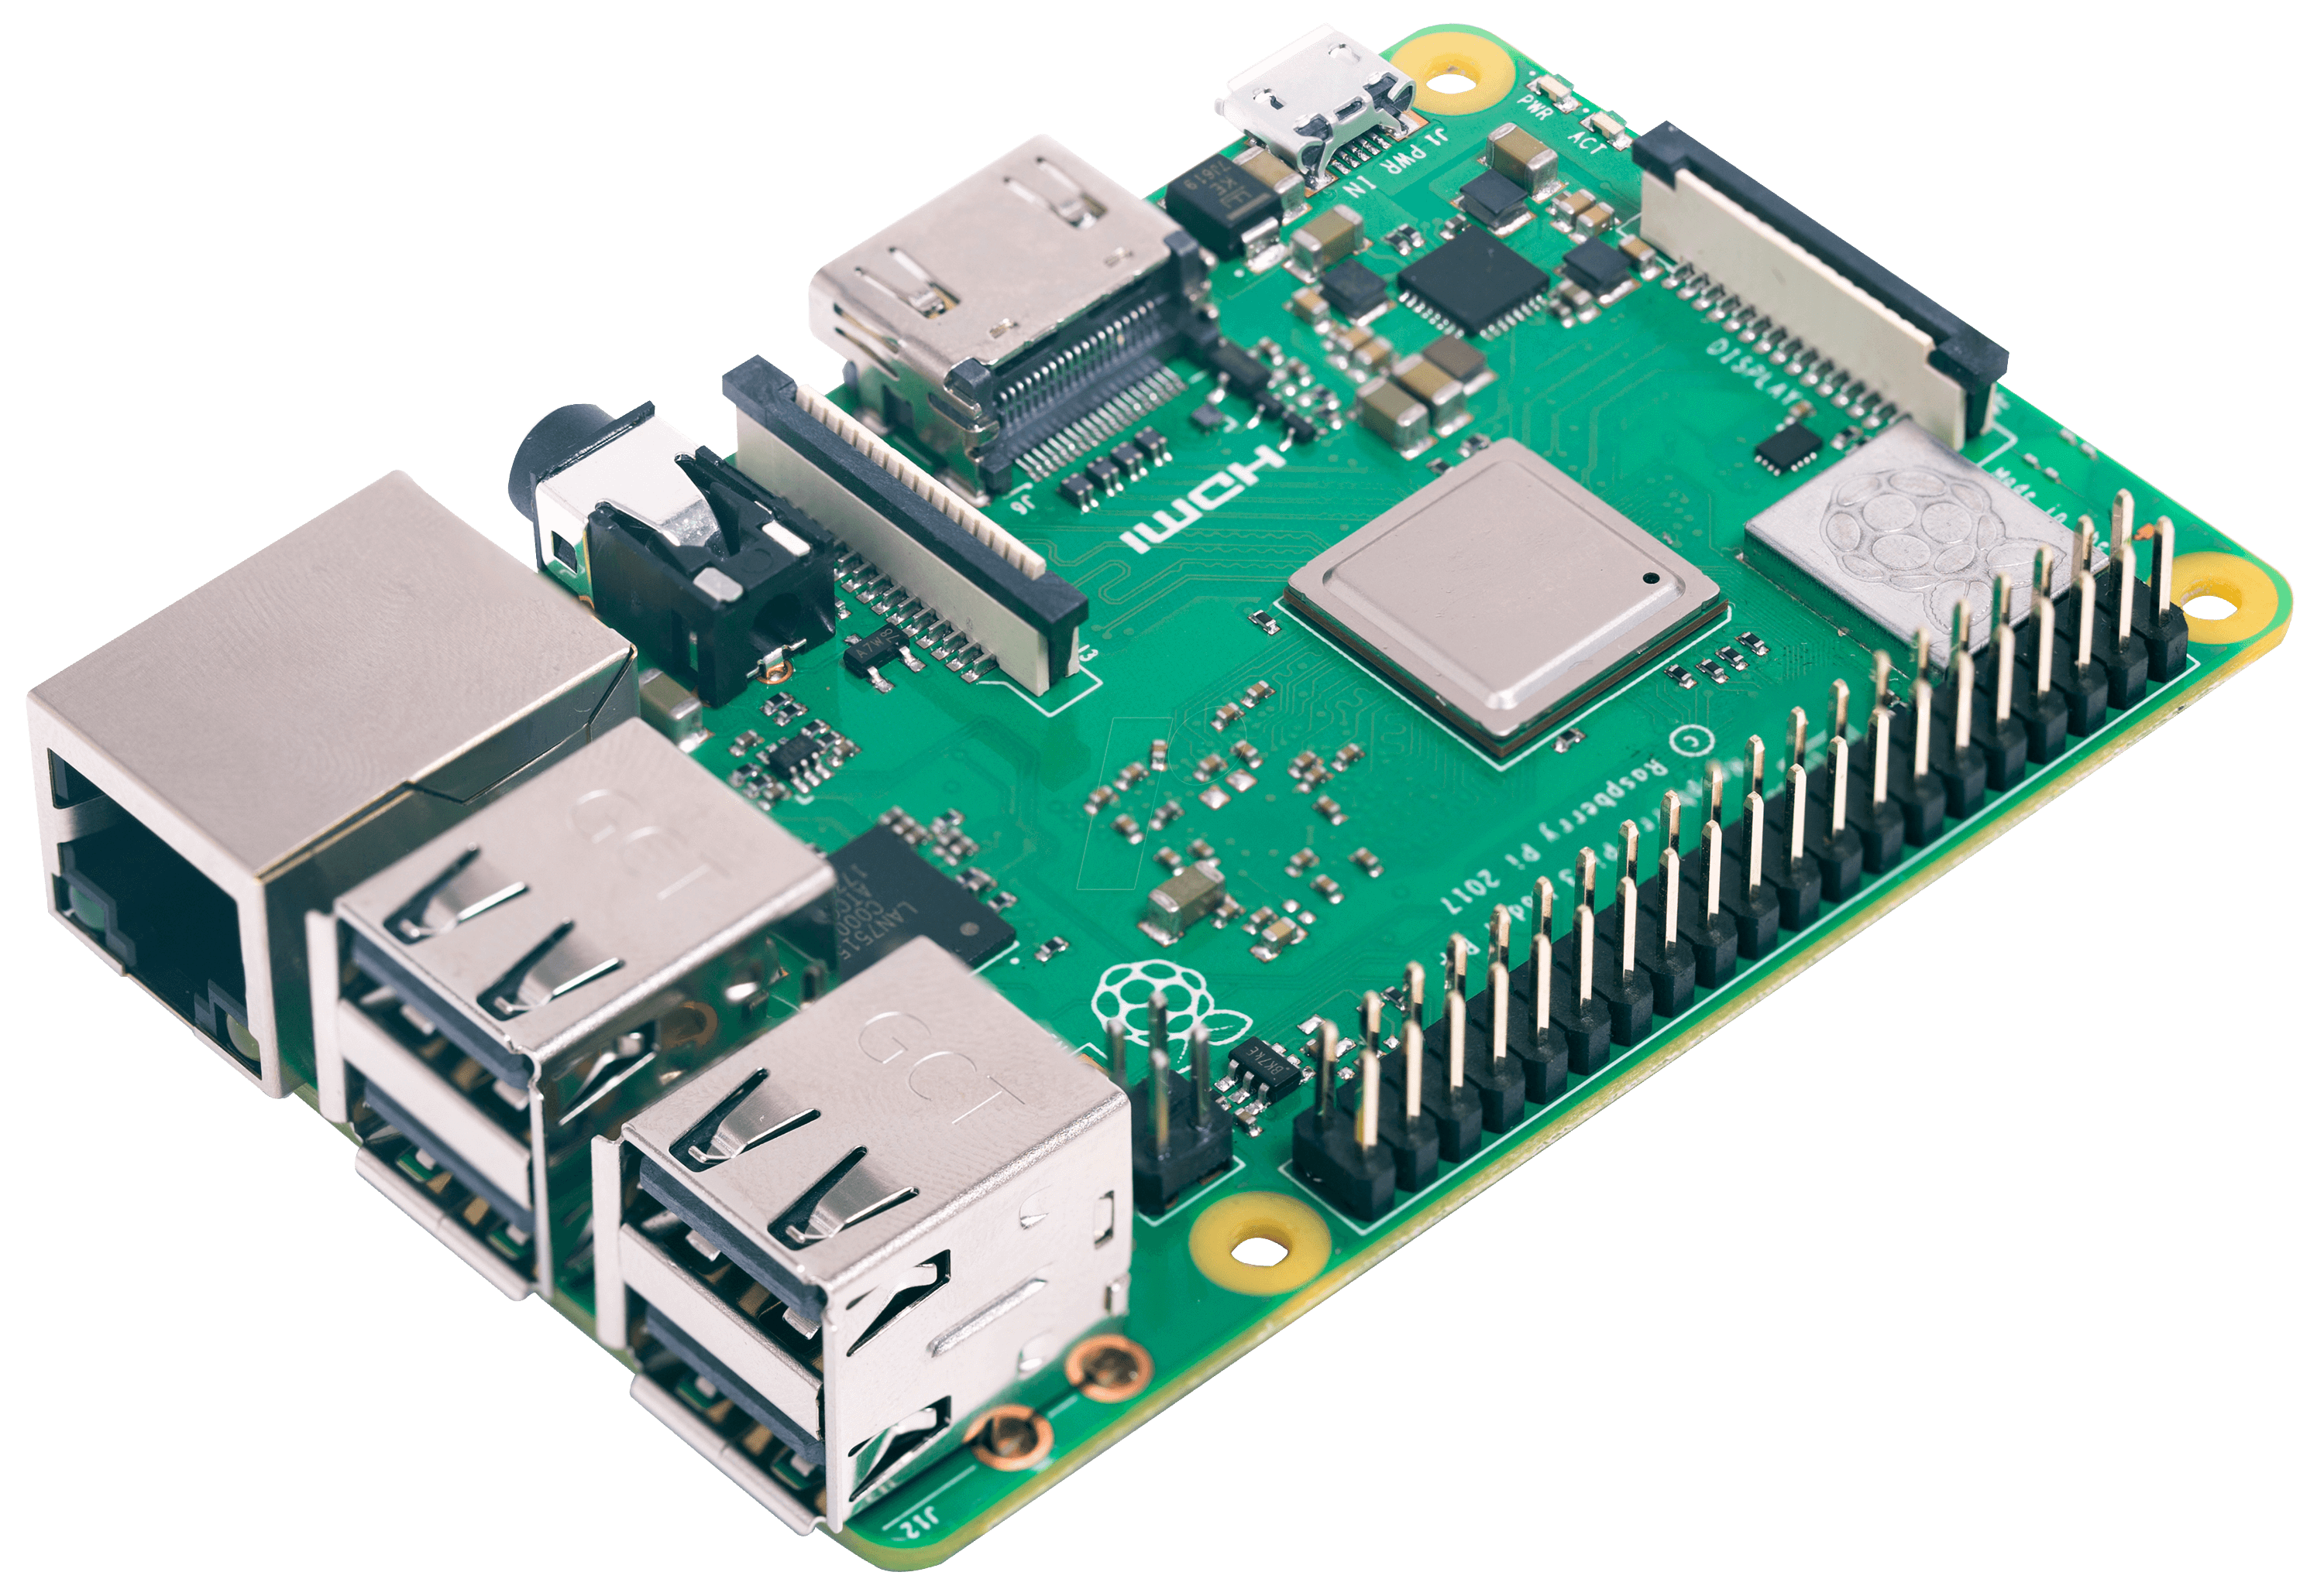
Tools Used
RTL SDR
Receiver for radio signals
Uses software defined radio (SDR)
Raspberry Pi
Device computer
Model 3B+

Slide 6
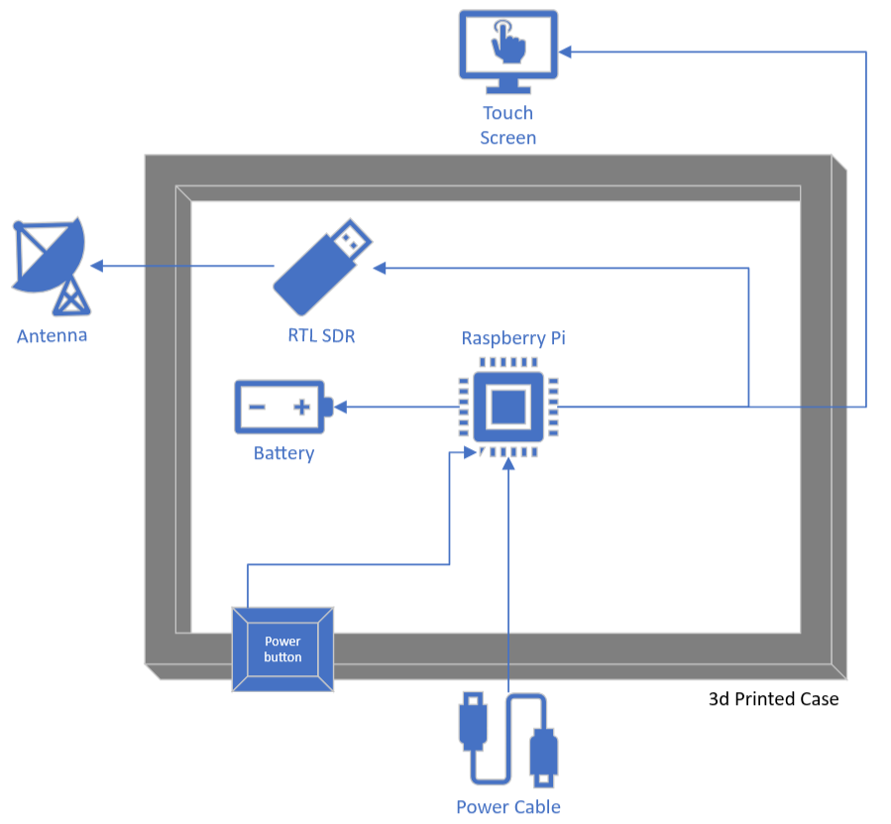
Architecture
Parts
RTL SDR Dongle
Raspberry Pi (3B+)
Touch Screen Display (7 Inch)
Rechargeable Battery (5000 mAh)
Power Switch
Antenna (SMA)
Cables (USB,HDMI)
Case (3D Printed)

Slide 7
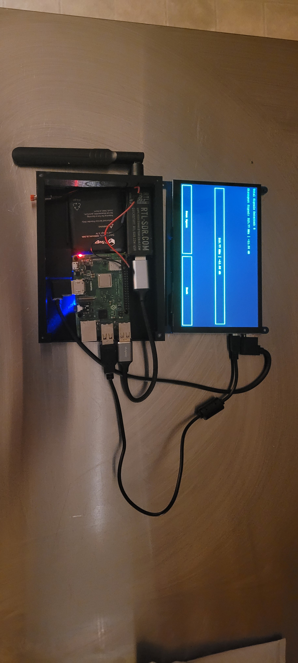
Architecture Picture

Slide 8
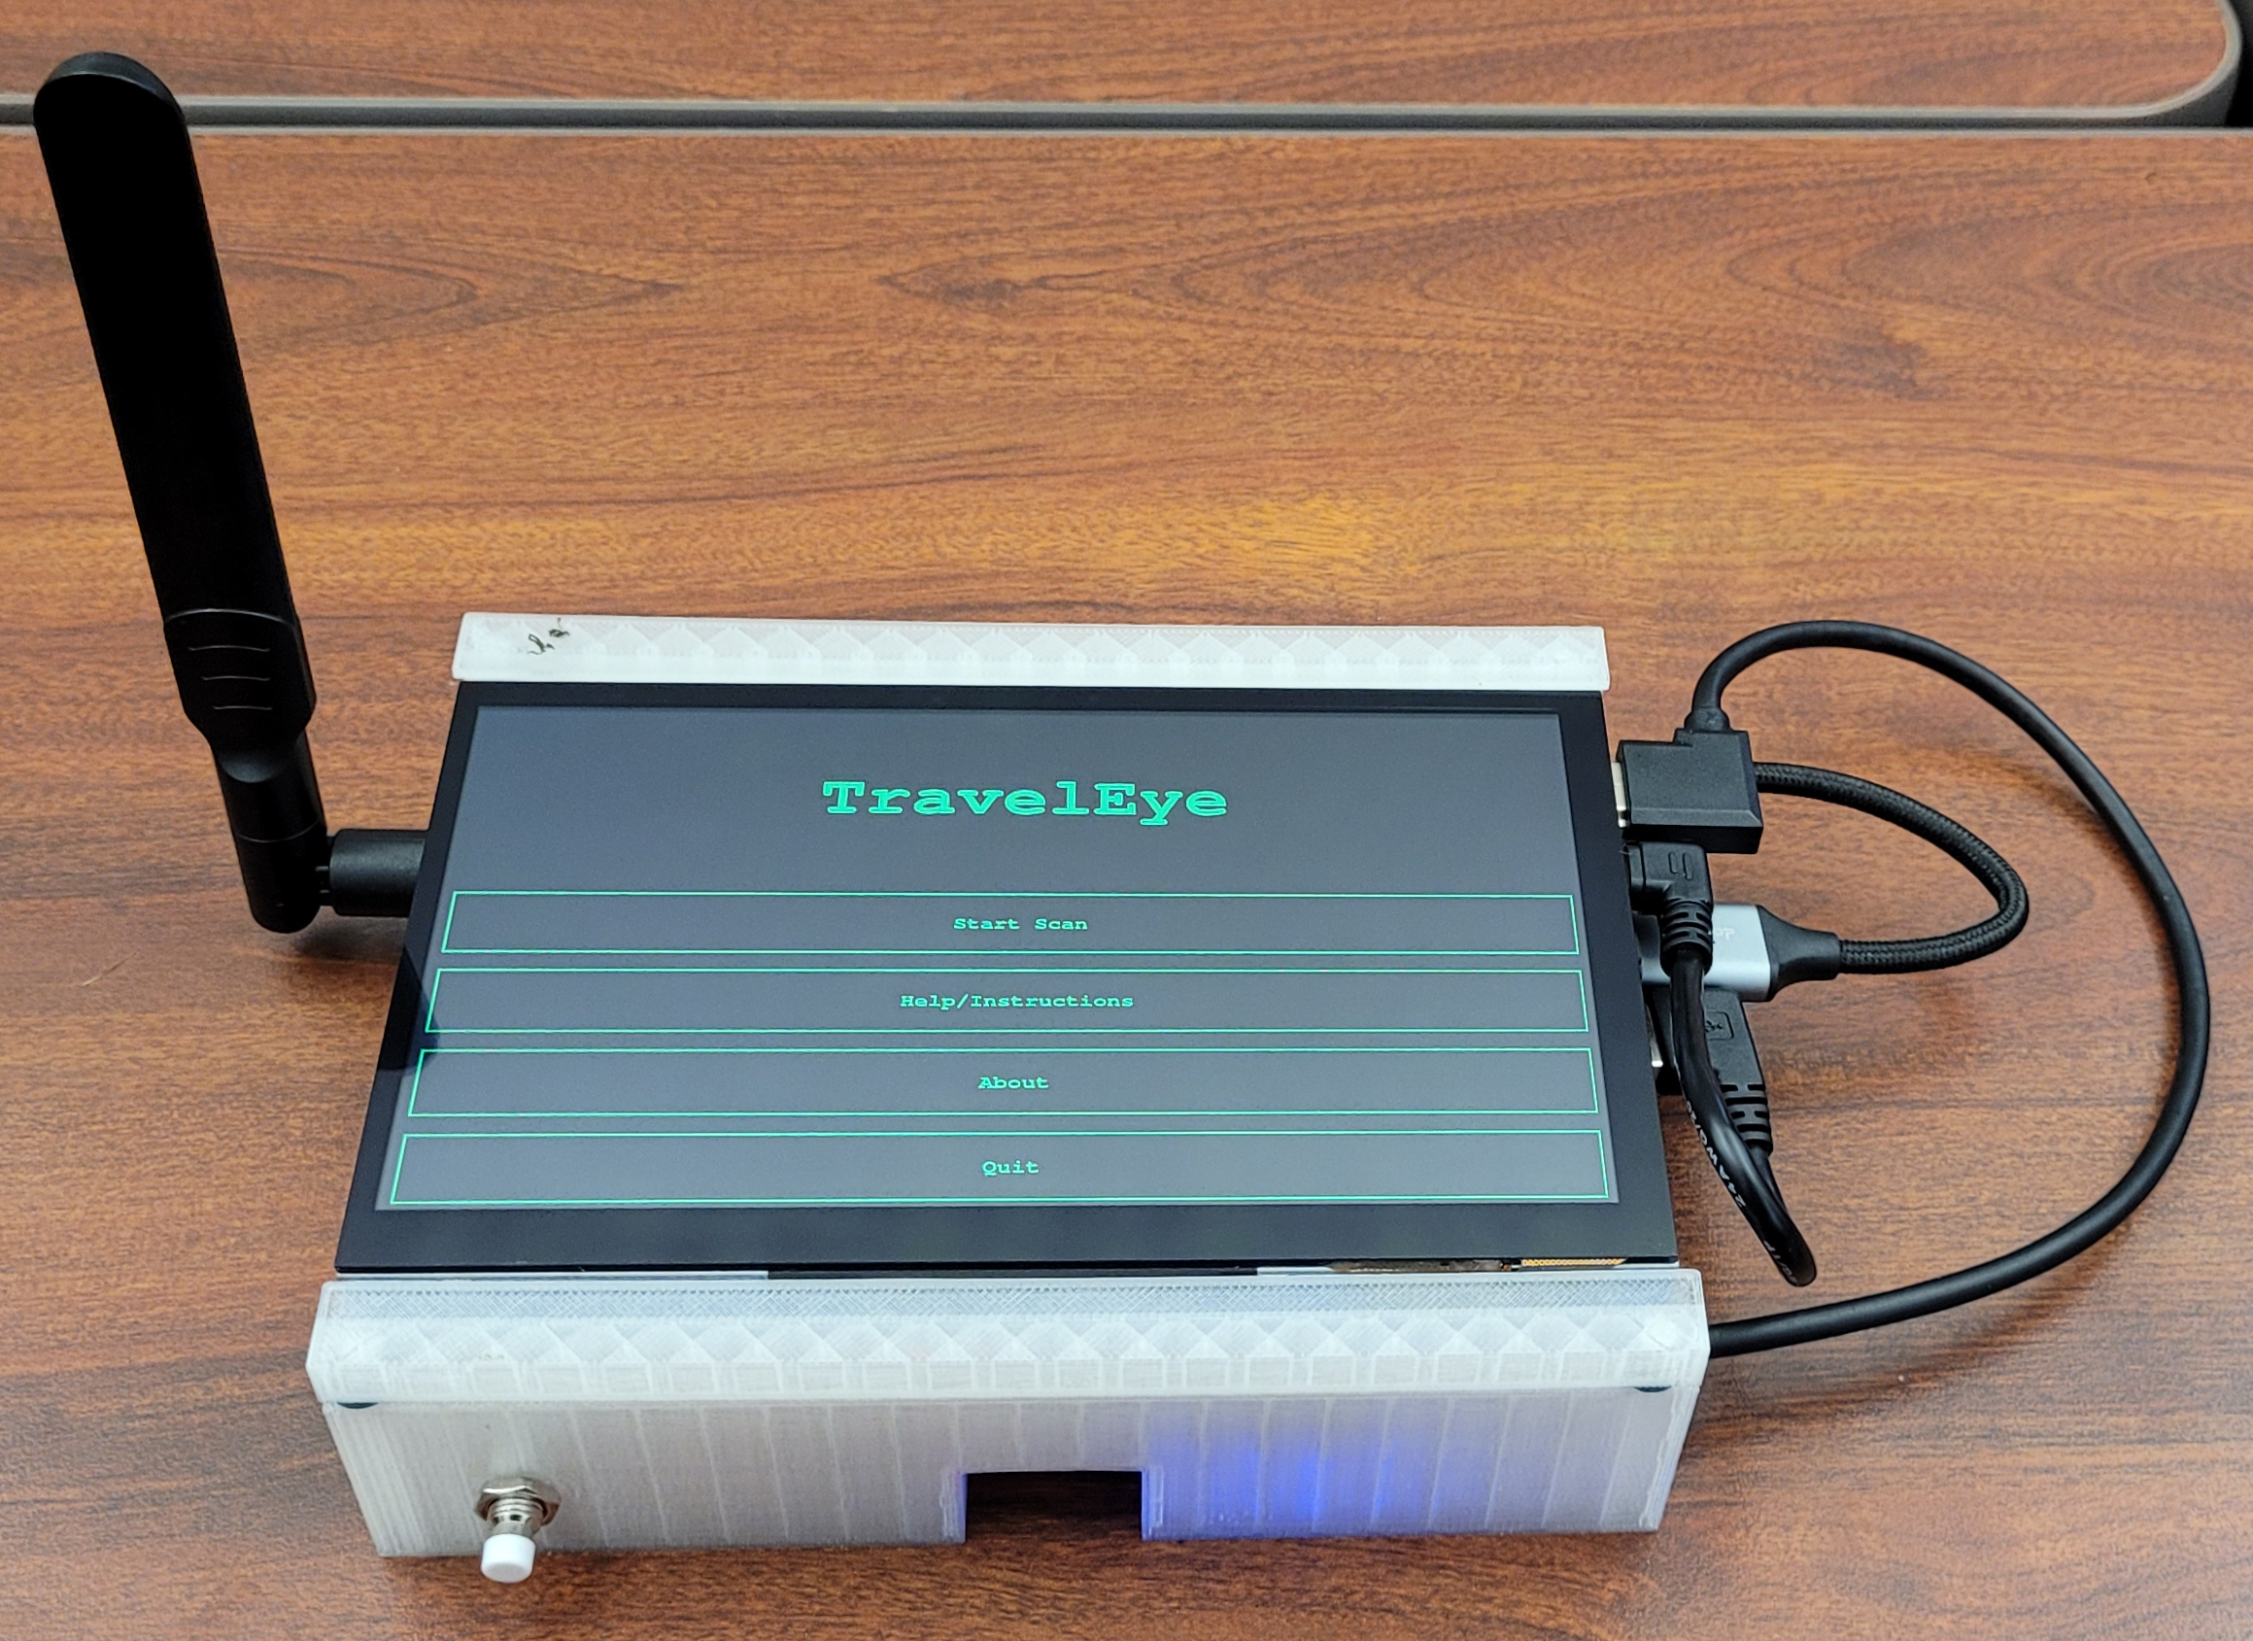
Final Device Assembled

Slide 9
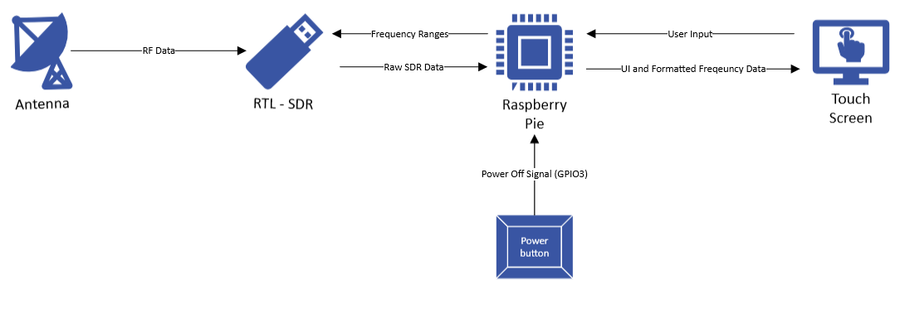
Data Flow

Slide 10
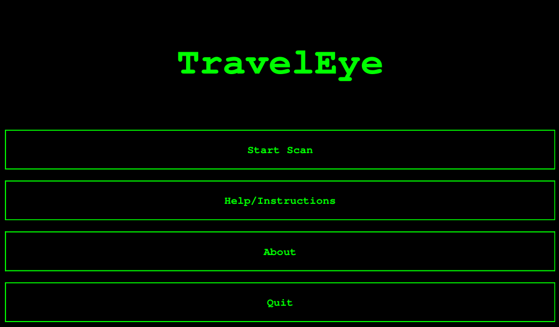
User Interface

Slide 11
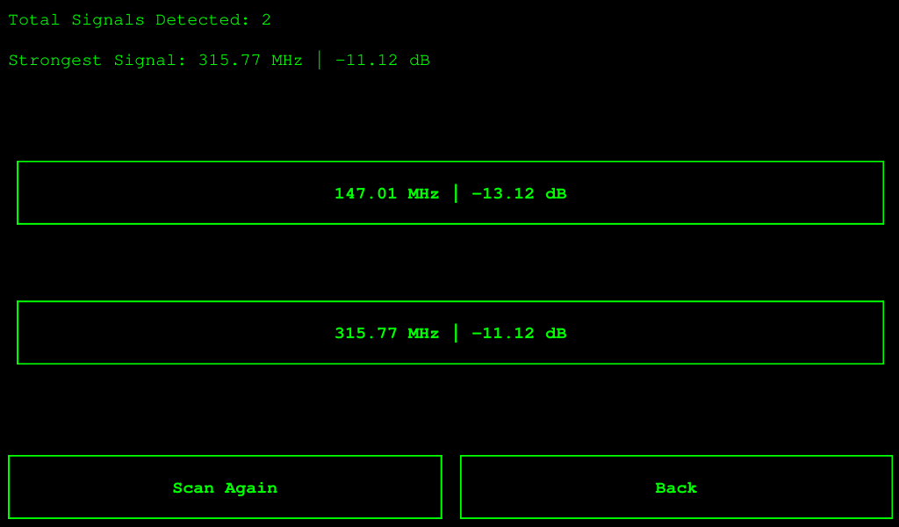
User Interface

Slide 12
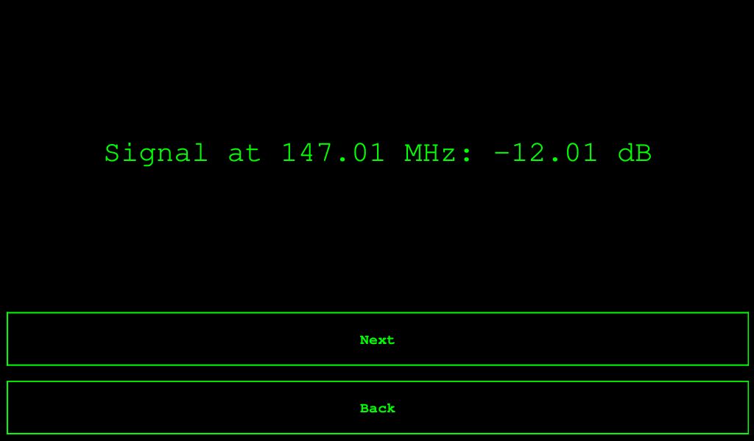
User Interface

Slide 13
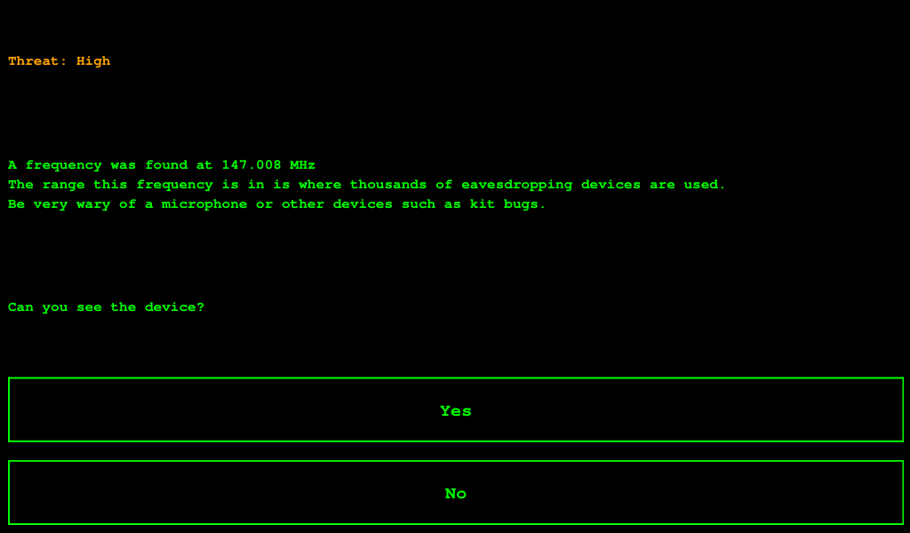
User Interface

Slide 14
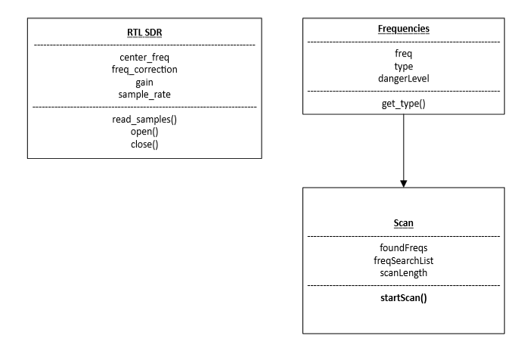
Class Diagram

Slide 15
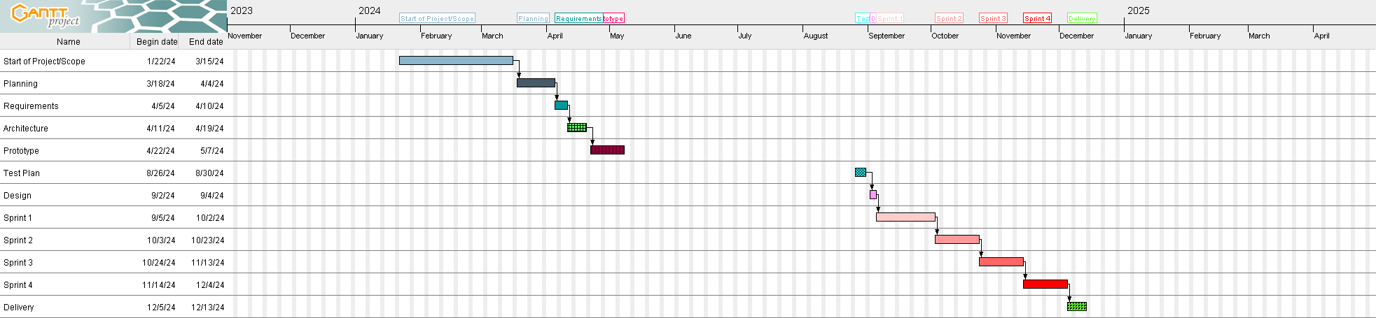
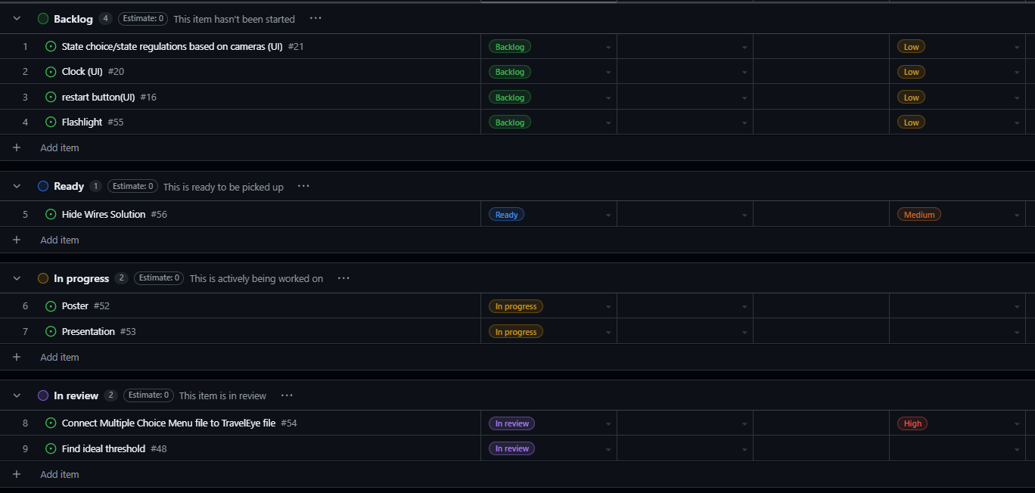
Project Management
Gantt chart - Very useful in planning when we could allocate additional time or focus on something else that needed more of our attention

Slide 16
Project Management
Kanban Board - Made it easy for everyone work on all aspects of the project, a UI designer could easily work on scanning tools, or the 3D modeler can join and help with the UI.

Slide 17
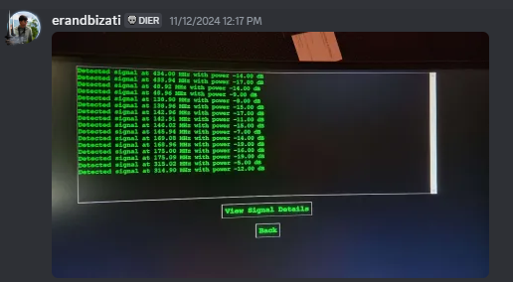
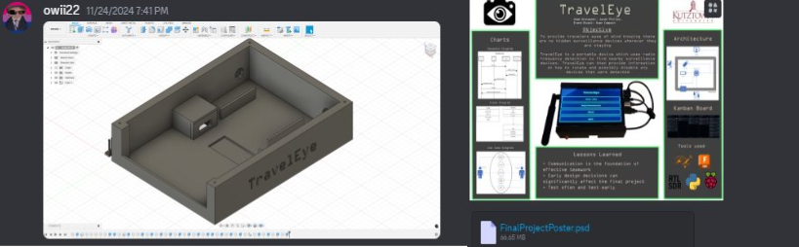
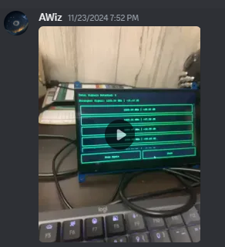
Project Management
Discord The platform allowed us have the proper tools for communication and planning which we needed to be effective.

Slide 18
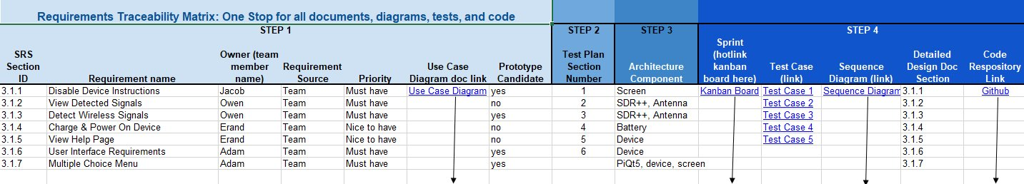
Project Management
Retrospectives and Requirements: These were key in ensuring we moved along at a steady pace, preventing us from stagnating or dwelling too long on an idea.

Slide 19
Risk Management
Main Issue Time vs Features, and what we wanted to incorporate and have implemented vs what would be smarter to leave alone and focus on other aspects
One year seems like a long time, but in reality, you arent spending a whole year working on it

Slide 20
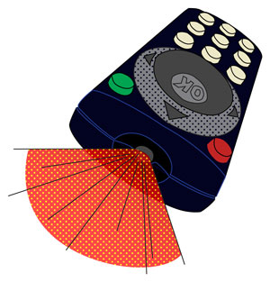



Risk Management
We wanted to implement various other features to the device such as: - Network Connectivity - Flashlight - Infared camera - IR blaster these didn’t work for various reasons

Slide 21
Risk Management
Trimming it all down, this helped us figure out what we wanted to do for 355, instead of having the broad scope of our original idea, focused on making something specific, that does its job really well

Slide 22
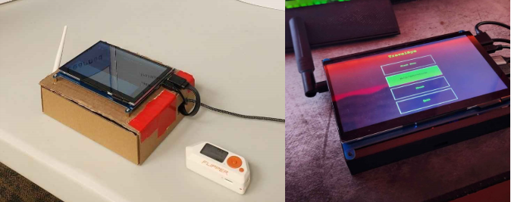
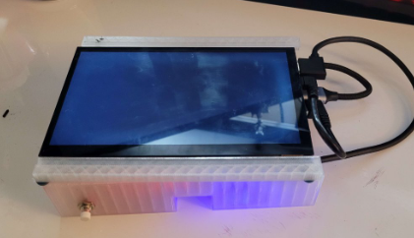
Risk Management
As an example, when developing the case we ran into several roadblocks: - 3D Modeling hiccups - Spatial Cramping - Parts breaking and getting trapped inside - Misprints - Ect..

Slide 23
Risk Management
Our main focus on something like the case was iterating on it in a way that almost retained the simplicity of the original carboard box. We didn't want to make things too overly complex (As much as we would've liked to), and we kept that ethos for most of the projects development

Slide 24
Test Results
Changed how we tested over time
Three different phases of testing
In the Beginning
Towards the Middle
Towards the End
Different tools used in each phase

Slide 25
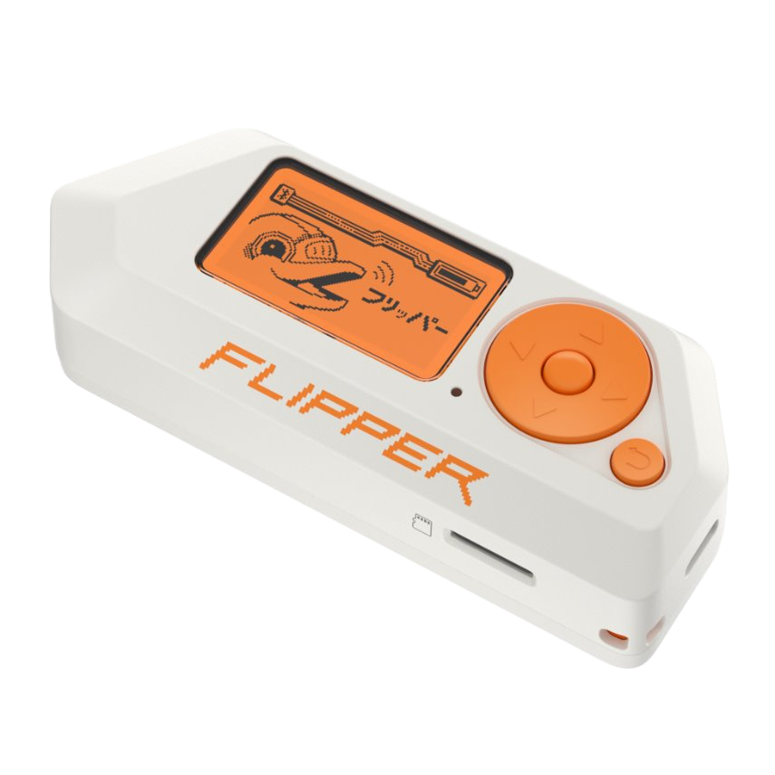
In the Beginning
Difficult to test frequencies
Costs lots of money to own each device with different frequencies
Used device called a Flipper Zero
Gives off different frequencies which we can choose
Helped test if the device was picking up all the frequencies we needed

Slide 26
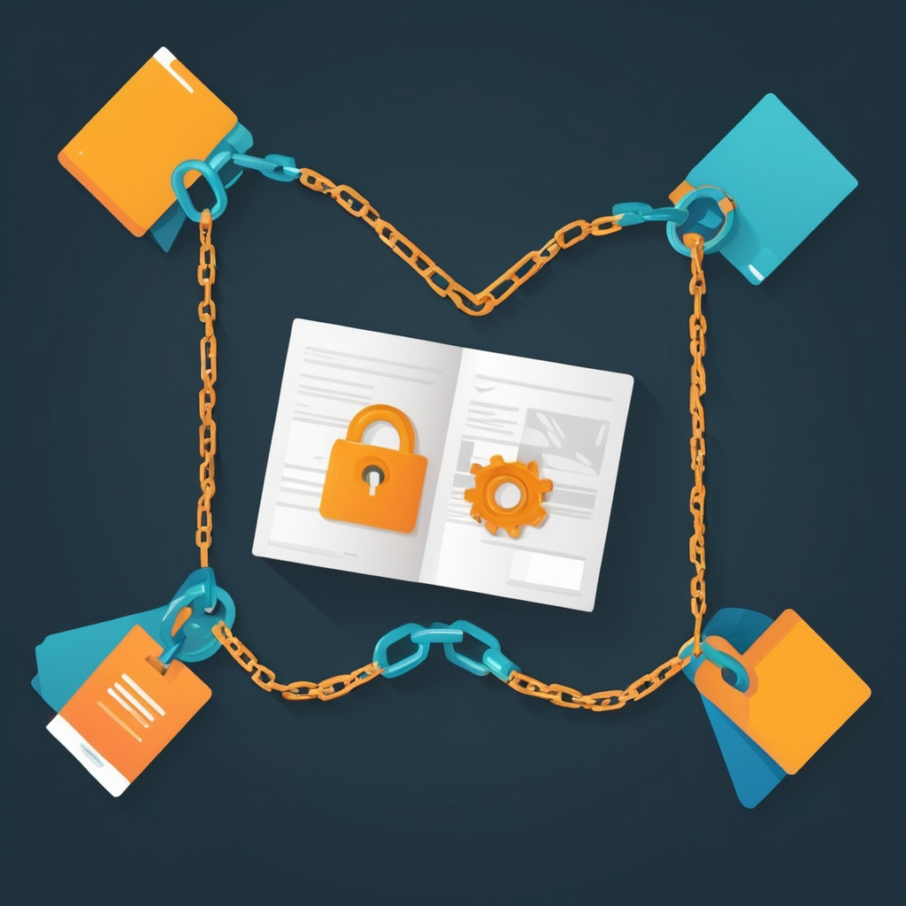
Towards the Middle
Test the application of program on device
Make sure UI and frequency tracking were working together seamlessly
Connect different files together without errors

Slide 27

Towards the End
Use different testers to interact with the device
Make sure the interface is accessible to anyone
Easy to use
No bugs that would ruin use of the device
Travelers can feel safe using it

Slide 28
Test Case
Project Name: Travel Eye | Sprint Number 3
Test Title: Detect Wireless Signal | Test Date: 11/4/2024
SRS Corresponding: Section 3.1.3 | Test Executed by: TipTapType
Description: Scan Various different signals to ensure that the scan will pick them up. The signal should be displayed if it could be determined, otherwise should show up as unknown. If no signal is present, there should be no signals detected.
Pre-condition (What do we assume): Scan was started
Dependencies (What do we need): Radio signal receiver working

Slide 29
Step | Test Steps | Test Data | Expected Results | Actual Results | Status | Notes
1. | Scan for signal from Flipper Zero | Set frequency sent from Flipper Zero | Signal is found | Signal is found | Pass | N/A
2. | Scan for signal from camera/microphone | Camera which emits a frequency | Signal is found | Signal is found | Pass | N/A
3. | Scan when no signal is present | N/A | No signal found | No signal found | Pass | N/A
4. | Scan when signal is in another room | Set frequency sent from Flipper Zero | Signal is found | No signal found | Fail | The Flipper Zero does not work from a far distance

Slide 30

Tool Teaser
Fusion
We used the software for designing a custom case
Developed by Autodesk
How it benefitted our project
Enabled precision case design
There were many tools available to help aid in designing the case.
Helpful for creating new iterations of the case
Great software for 3d printing

Slide 31
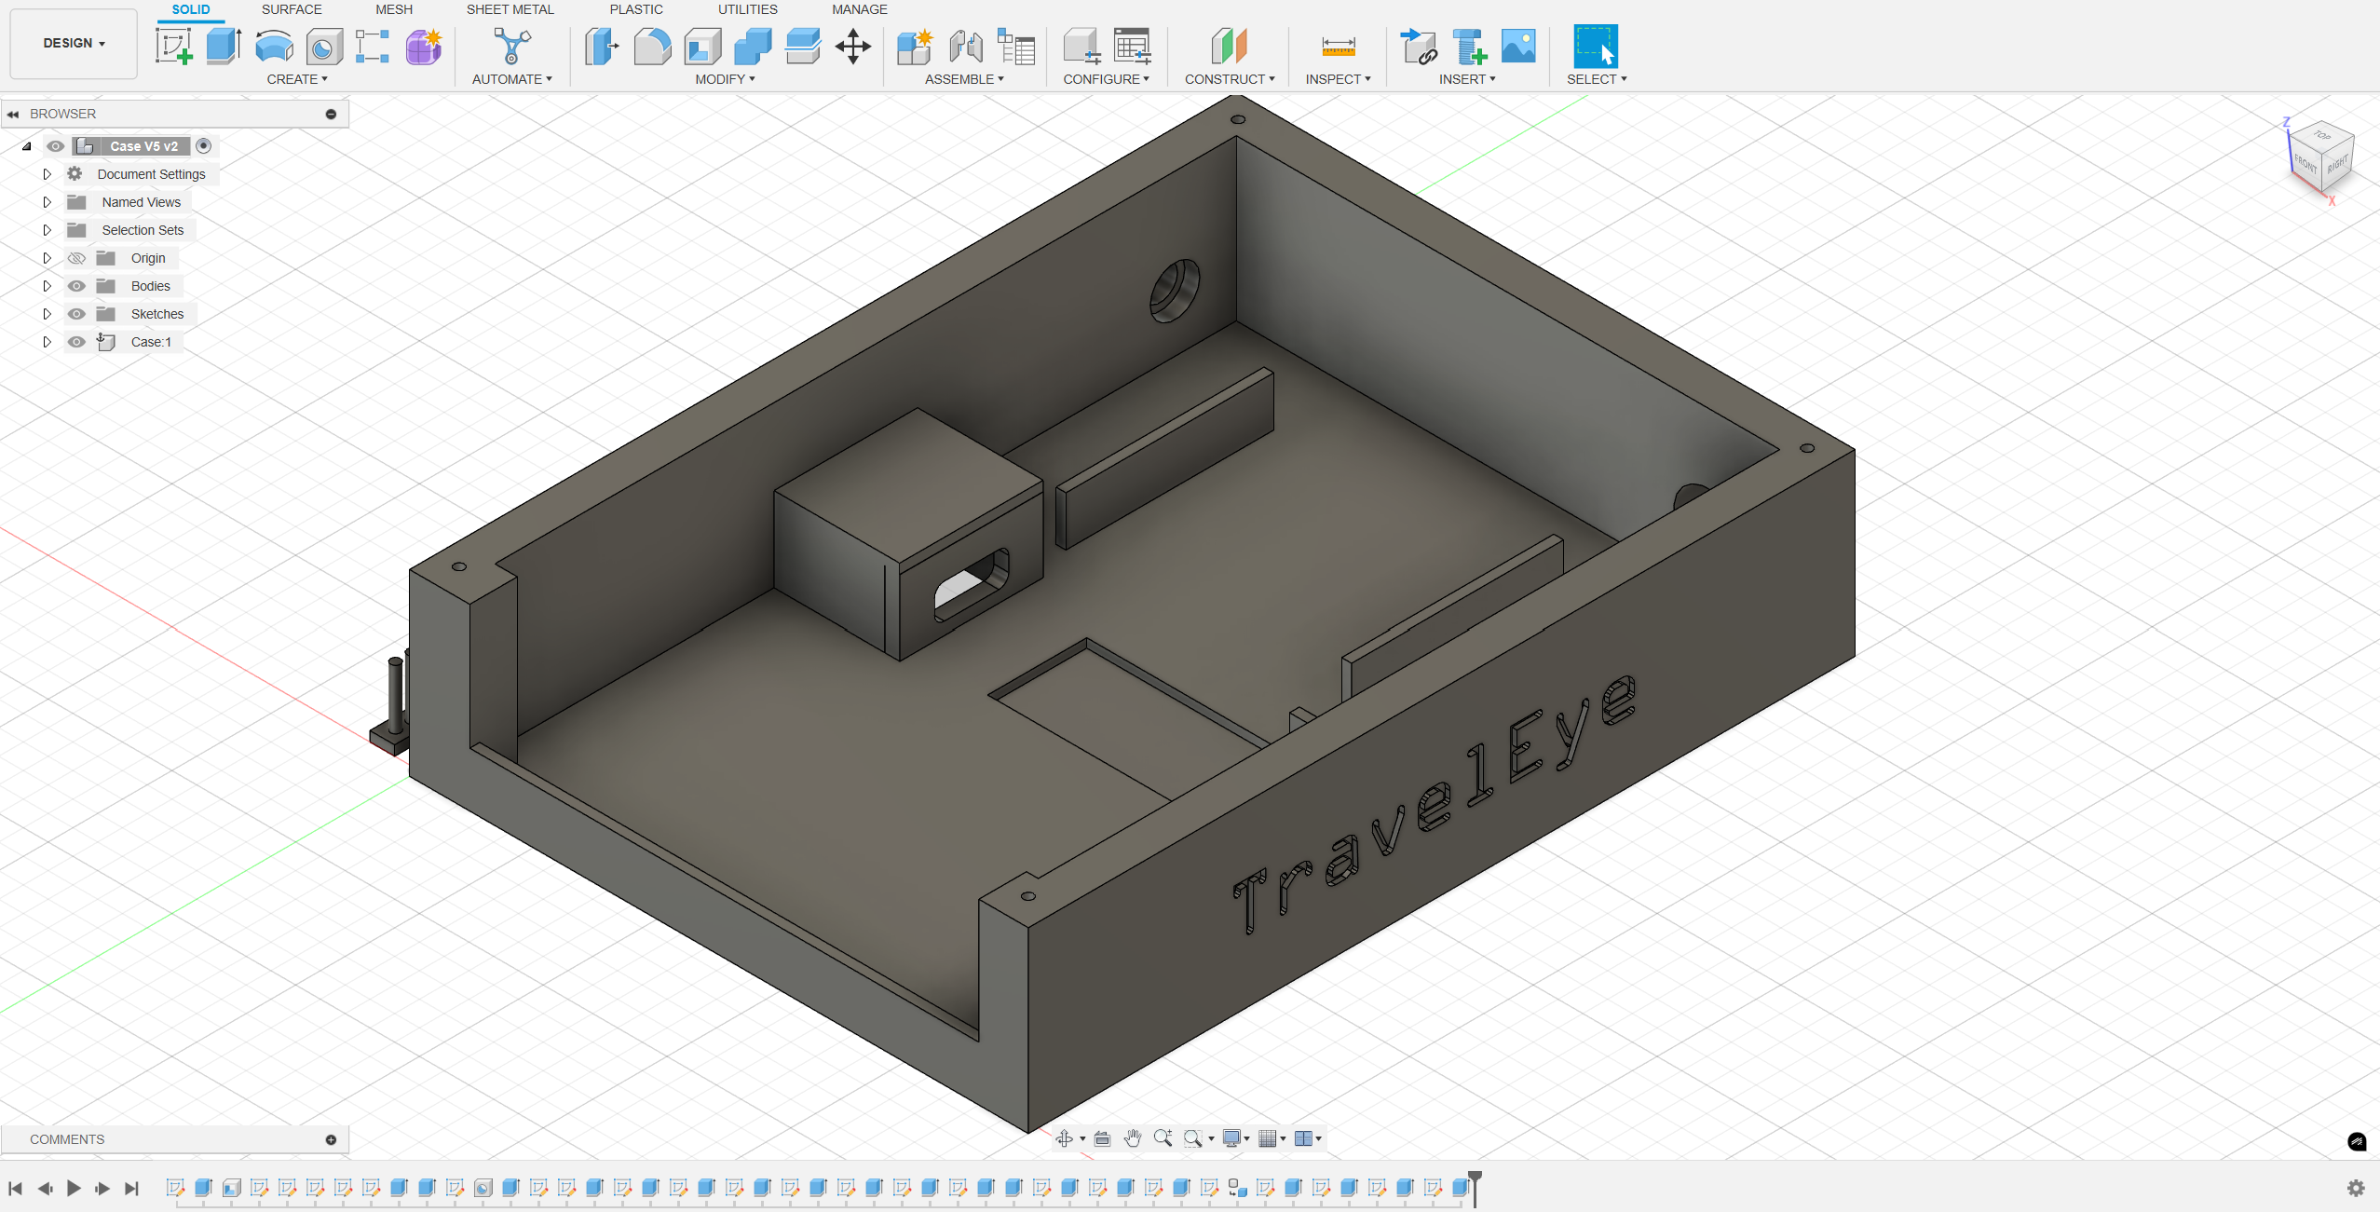
Fusion 360

Slide 32
Demo
Flipper Zero
433.92 MHz
The device will pick up the signal when it is being sent
Watch how the strength changes as it gets closer and farther away
Video Backup

Slide 33
Lessons Learned
Biggest challenges/roadblocks
Communication
Starting things early
Difficulty testing on device
Importance of having 2 test devices
Python UI formatting issues with Tkinter

Slide 34
Lessons Learned
Biggest lesson learned
Clear and regular communication ensures that all components of a project come together cohesively.
One sentence take away
Start early and communicate effectively to keep everyone aligned and ensure tasks are complete on time.

Slide 35
Thanks for listening Any questions?

